Slide 1
CSE 417T Introduction to Machine Learning
Lecture 5 Instructor: Chien-Ju (CJ) Ho

Slide 2
Logistics: Homework 1
Due: Feb 14 (Monday), 2022
http://chienjuho.com/courses/cse417t/hw1.pdf
Intended deadline: Feb 10.
Recommend to work on it early to spare time for homework 2
Two submission links: Report and Code
Report: Answer all questions, including the implementation question
Grades are based on the report
Code: Complete and submit hw1.py for Problem 2
The code will only be used for correctness checking (when in doubts) and plagiarism checking
Reserve time if you never used Gradescope.
Make sure to specify the pages for each problem. You won’t get points otherwise

Slide 3
Logistics: Office Hours
TA Office Hours
60 minutes per session
Please follow Piazza for additional information
Recommendation: Try to utilize the office hour early (way ahead of deadlines), you are likely to get more of TAs’ time this way
Monday | 11:30am (Herbert Zhou) | 4pm (Dean Yu)
Tuesday | 1pm (Ziqi Xu) | 3:30pm (Neal Huang)
Wednesday | 1pm (Eddie Choi) | 4:30pm (Weiwei Ma)
Thursday | 10am (Jackie Zhong) | 3pm (Fankun Zeng)
Friday | 8am (Shohaib Shaffiey) | 1pm (Yunfan Wang) | 7pm (Hao Qin)
Sunday | 1pm (Jonathan Ma)

Slide 4
Recap

Slide 5


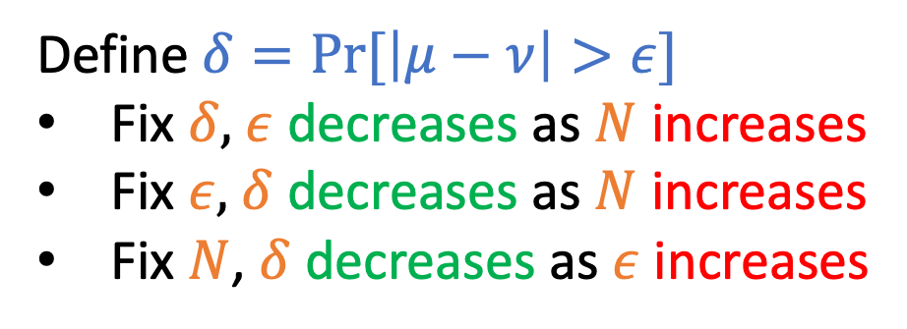
Hoeffding’s Inequality
$$\operatorname{Pr}\left[\left|μ−ν\right|>ε\right]≤2e^{−2ε^{2}N}$$
Draw with replacement
Define $δ=Pr⁡[\left|μ−ν\right|>ε]$
Fix $δ,$ $ε$ decreases as $N$ increases
Fix $ε,$ $δ$ decreases as $N$ increases
Fix $N$, $δ$ decreases as $ε$ increases
N: number of samples
Informal intuitions of notations $N:$ # sample $δ:$ probability of “bad” event
$ε:$ error of estimation

Slide 6
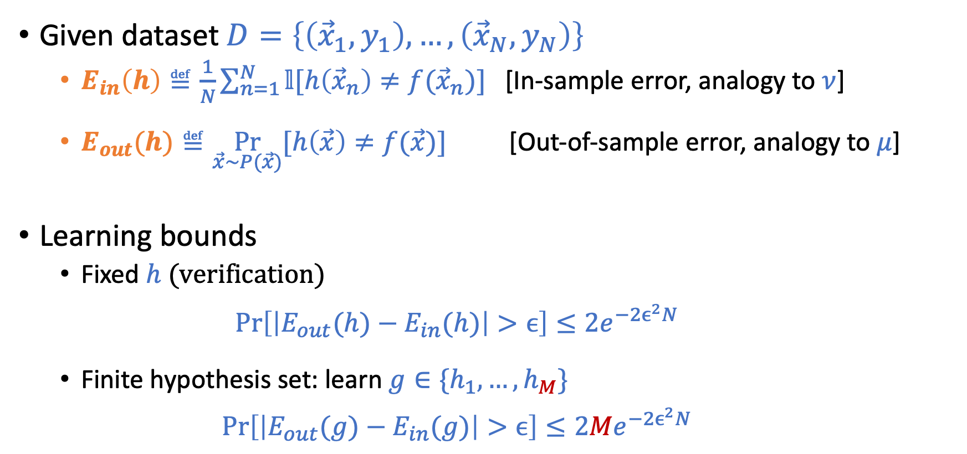
Connection to Learning
Given dataset $D=\left\{\left({\vec{x}}_{1},y_{1}\right),…,\left({\vec{x}}_{N},y_{N}\right)\right\}$
$E_{in}\left(h\right)≝\frac{1}{N}\sum_{n=1}^{N}{𝕝[h\left({\vec{x}}_{n}\right)≠f({\vec{x}}_{n})]}$ [In-sample error, analogy to $ν$]
$E_{out}(h)≝\underset{\vec{x}\sim P(\vec{x})}{Pr}{[h\left(\vec{x}\right)≠f(\vec{x})]}$ [Out-of-sample error, analogy to $μ$]
Learning bounds
Fixed $h$ (verification) $\operatorname{Pr}\left[\left|E_{out}(h)−E_{in}(h)\right|>ϵ\right]≤2e^{−2ϵ^{2}N}$
Finite hypothesis set: learn $g∈\{h_{1},…,h_{M}\}$ $\operatorname{Pr}\left[\left|E_{out}(g)−E_{in}(g)\right|>ϵ\right]≤2{Me}^{−2ϵ^{2}N}$

Slide 7
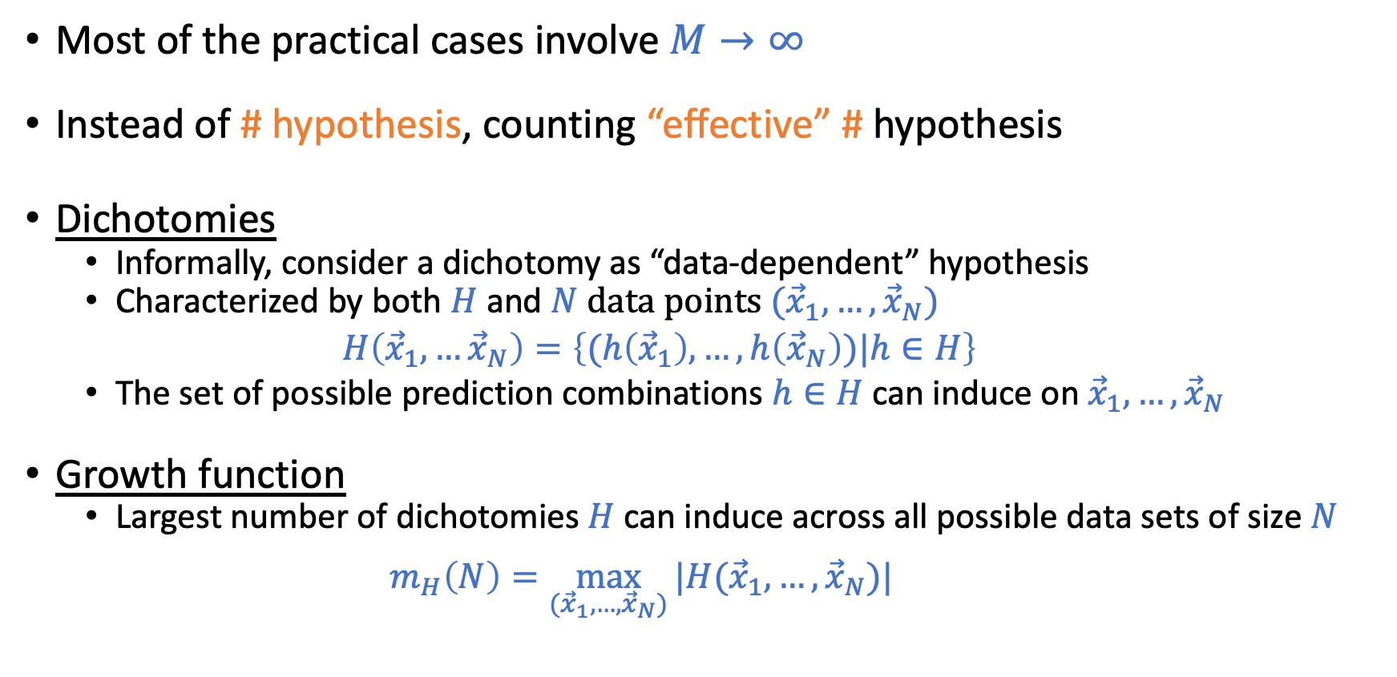

Dealing with Infinite Hypothesis Set: $M→∞$
Most of the practical cases involve $M→∞$
Instead of # hypothesis, counting “effective” # hypothesis
Dichotomies
Informally, consider a dichotomy as “data-dependent” hypothesis
Characterized by both $H$ and $N$ data points $({\vec{x}}_{1},…,{\vec{x}}_{N})$ $H\left({\vec{x}}_{1},…{\vec{x}}_{N}\right)=\left\{(h\left({\vec{x}}_{1}\right),…,h\left({\vec{x}}_{N}\right))|h∈H\right\}$
The set of possible prediction combinations $h∈H$ can induce on${\vec{x}}_{1},…,{\vec{x}}_{N}$
Growth function
Largest number of dichotomies $H$can induce across all possible data sets of size $N$
$m_{H}\left(N\right)=\max_{({\vec{x}}_{1},…,{\vec{x}}_{N})}{|H({\vec{x}}_{1},…,{\vec{x}}_{N})|}$

Slide 8
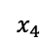
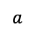
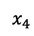
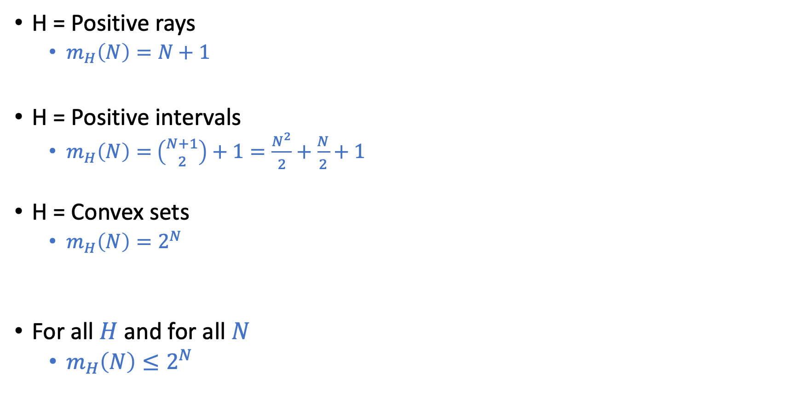
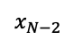
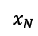
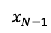
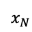
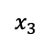
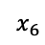
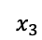
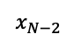
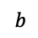
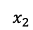
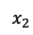
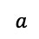
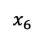
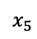
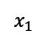
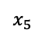
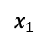
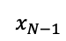
Examples on Growth Functions
Predict -1
Predict +1
H = Positive rays
$m_{H}\left(N\right)=N+1$
H = Positive intervals
$m_{H}\left(N\right)=$ $\left({N+1 \atop 2}\right)+1=\frac{N^{2}}{2}+\frac{N}{2}+1$
H = Convex sets
$m_{H}\left(N\right)=2^{N}$
For all $H$ and for all $N$
$m_{H}\left(N\right)≤2^{N}$
…
$$x_{1}$$
$$x_{2}$$
$$x_{3}$$
$$x_{4}$$
$$x_{5}$$
$$x_{6}$$
$$x_{N−2}$$
$$x_{N−1}$$
$$x_{N}$$
$$a$$
Predict -1
Predict +1
Predict -1
…
$$x_{1}$$
$$x_{2}$$
$$x_{3}$$
$$x_{4}$$
$$x_{5}$$
$$x_{6}$$
$$x_{N−2}$$
$$x_{N−1}$$
$$x_{N}$$
$$a$$
$$b$$
Predcit +1
Predict -1

Slide 9
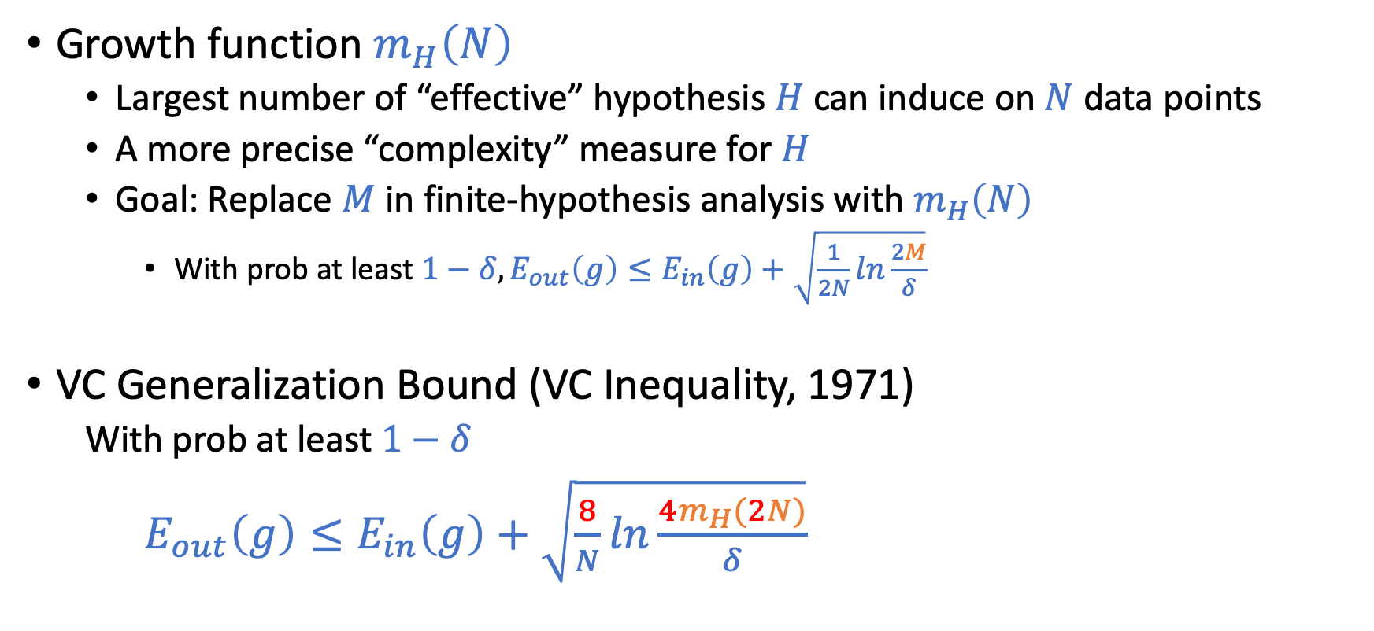
Why Growth Function?
Growth function $m_{H}\left(N\right)$
Largest number of “effective” hypothesis $H$ can induce on $N$ data points
A more precise “complexity” measure for $H$
Goal: Replace $M$ in finite-hypothesis analysis with $m_{H}\left(N\right)$
With prob at least $1−δ, E_{out}\left(g\right)≤E_{in}\left(g\right)+\sqrt{\frac{1}{2N}ln\frac{2M}{δ}}$
VC Generalization Bound (VC Inequality, 1971)
With prob at least $1−δ$
$E_{out}\left(g\right)≤E_{in}\left(g\right)+\sqrt{\frac{8}{N}ln\frac{4m_{H}(2N)}{δ}}$

Slide 10
Today’s Lecture
The notes are not intended to be comprehensive. They should be accompanied by lectures and/or textbook.
Let me know if you spot errors.

Slide 11
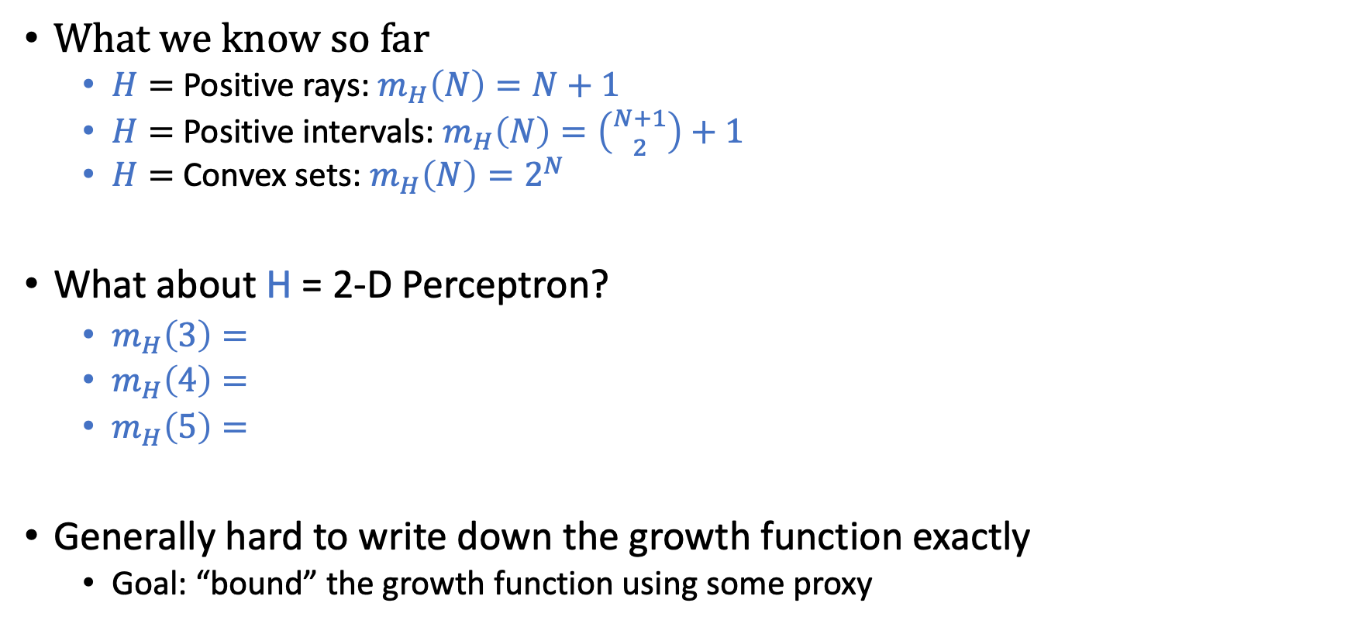
Bounding Growth Function
What we know so far
$H=$ Positive rays: $m_{H}\left(N\right)=N+1$
$H=$ Positive intervals: $m_{H}\left(N\right)=\left({N+1 \atop 2}\right)+1$
$H=$ Convex sets: $m_{H}\left(N\right)=2^{N}$
What about H = 2-D Perceptron?
$m_{H}\left(3\right)=$
$m_{H}\left(4\right)=$
$m_{H}\left(5\right)=$
Generally hard to write down the growth function exactly
Goal: “bound” the growth function using some proxy
8
14
?

Slide 12

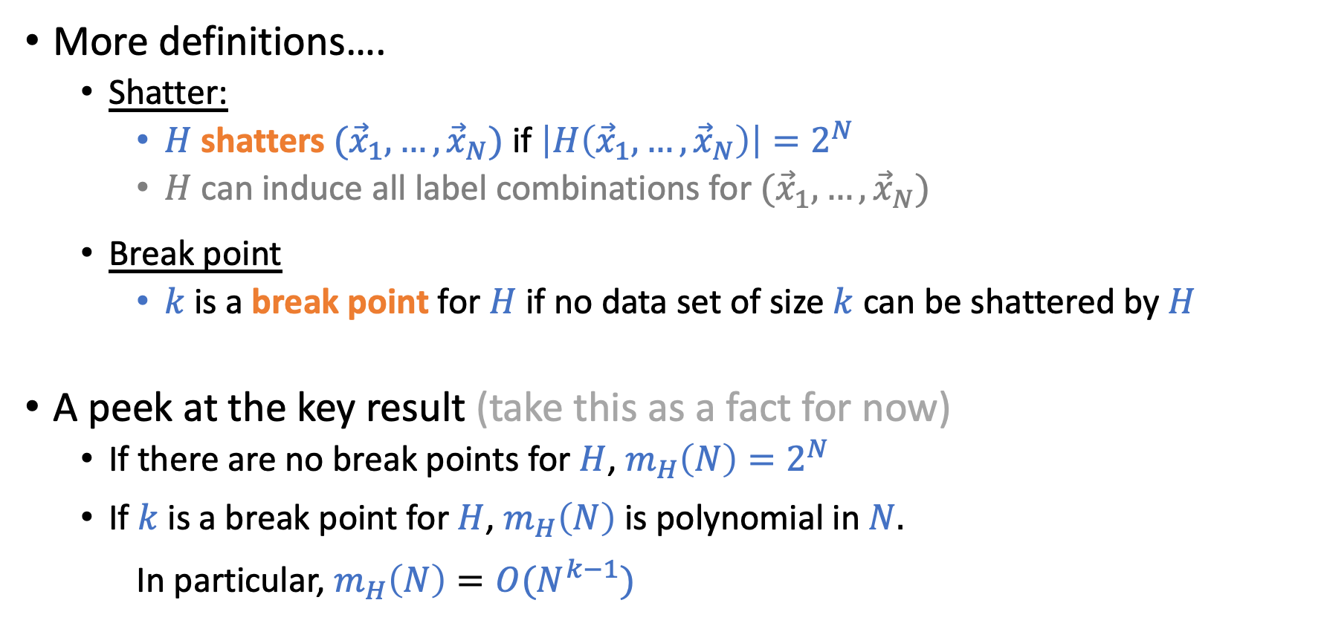
Bounding Growth Function
More definitions….
Shatter:
$H$ shatters $({\vec{x}}_{1},…,{\vec{x}}_{N})$ if $\left|H\left({\vec{x}}_{1},…,{\vec{x}}_{N}\right)\right|=2^{N}$
$H$ can induce all label combinations for $({\vec{x}}_{1},…,{\vec{x}}_{N})$
Break point
$k$ is a break point for $H$ if no data set of size $k$ can be shattered by $H$
A peek at the key result (take this as a fact for now)
If there are no break points for $H$, $m_{H}\left(N\right)=2^{N}$
If $k$ is a break point for $H$, $m_{H}\left(N\right)$ is polynomial in $N.$ In particular, $m_{H}\left(N\right)=O(N^{k−1})$
A bit more accurately:
$m_{H}\left(N\right)≤\sum_{i=1}^{k−1}{\left({N \atop i}\right)}$, or
$m_{H}\left(N\right)≤N^{k−1}+1$

Slide 13
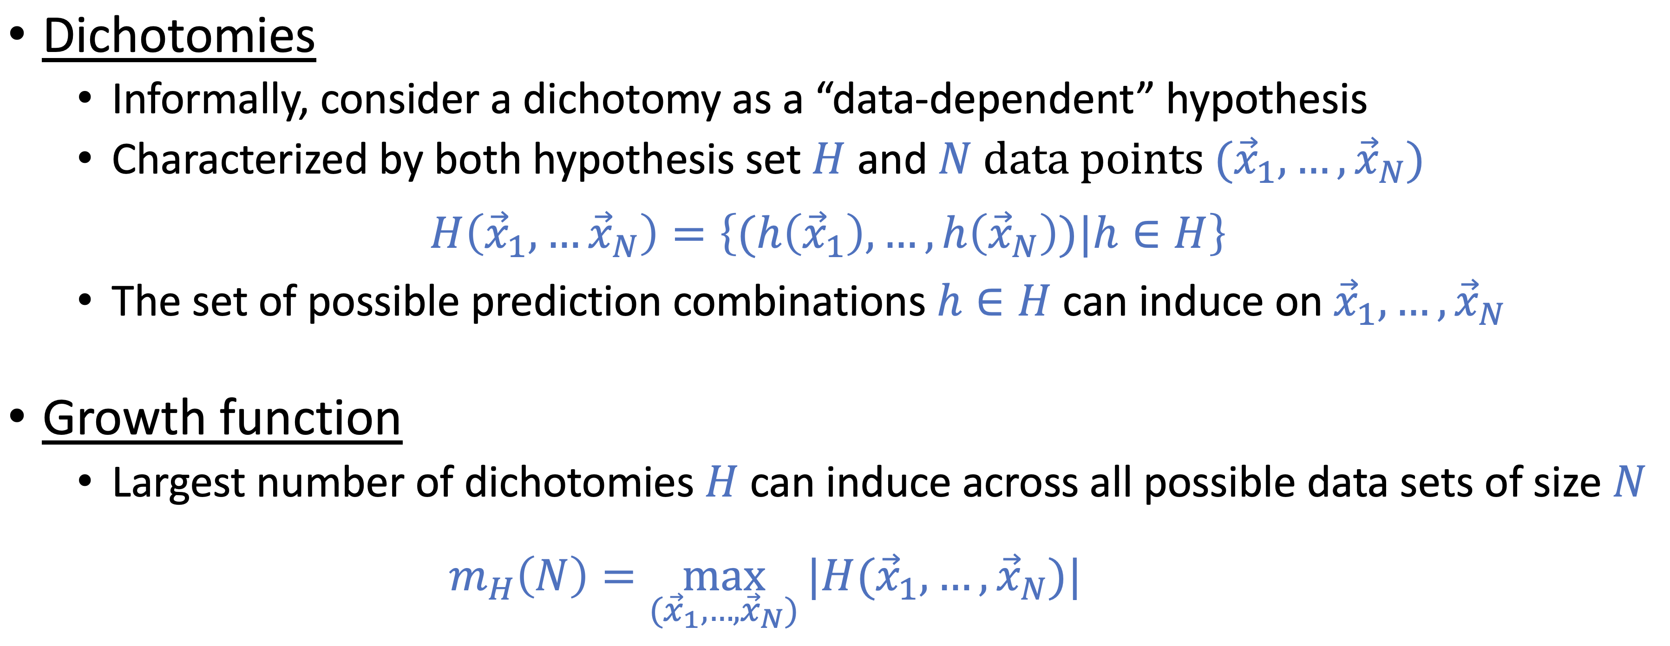

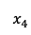
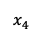
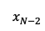
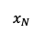
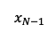
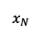
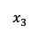
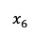
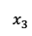
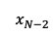
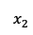
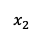
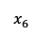
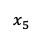
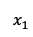
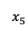
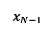
Practice
What are the break points for
1. Positive Rays
2. Positive Intervals
3. Convex Sets
4. 2-D Perceptron
Predict -1
Predict +1
Predict -1
Predict +1
Predict -1
Predcit +1
$$x_{1}$$
$$x_{2}$$
$$x_{3}$$
$$x_{4}$$
$$x_{5}$$
$$x_{6}$$
…
$$x_{N−2}$$
$$x_{N−1}$$
$$x_{N}$$
…
Predict -1
$$x_{1}$$
$$x_{2}$$
$$x_{3}$$
$$x_{4}$$
$$x_{5}$$
$$x_{6}$$
$$x_{N−2}$$
$$x_{N−1}$$
$$x_{N}$$
$$a$$
$$a$$
$$b$$

Slide 14
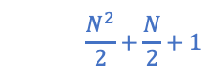

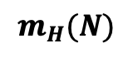
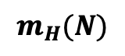
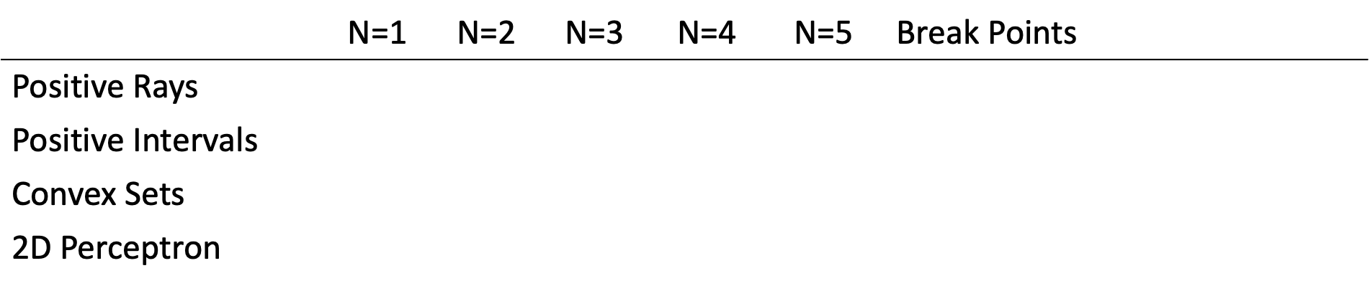

Practice
$$m_{H}(N)$$
$$m_{H}(N)$$
 | N=1 | N=2 | N=3 | N=4 | N=5 | Break Points | VC Dimension
Positive Rays | 2 | 3 | 4 | 5 | 6 | $$k=2,3,4,…$$ | 1
Positive Intervals | 2 | 4 | 7 | 11 | 16 | $$k=3,4,5,…$$ | 2
Convex Sets | 2 | 4 | 8 | 16 | 32 | None | $$∞$$
2D Perceptron | 2 | 4 | 8 | 14 | ? | $$k=4,5,6,…$$ | 3
$$N+1$$
$$\frac{N^{2}}{2}+\frac{N}{2}+1$$
$$2^{N}$$

Slide 15

Practice
$$m_{H}(N)$$
$$m_{H}(N)$$
 | N=1 | N=2 | N=3 | N=4 | N=5 | Break Points | VC Dimension
Positive Rays | 2 | 3 | 4 | 5 | 6 | $$k=2,3,4,…$$ | 1
Positive Intervals |  |  |  |  |  |  | 2
Convex Sets |  |  |  |  |  |  | $$∞$$
2D Perceptron |  |  |  |  |  |  | 3
$$N+1$$
$$\frac{N^{2}}{2}+\frac{N}{2}+1$$
$$2^{N}$$

Slide 16


Practice
$$m_{H}(N)$$
$$m_{H}(N)$$
 | N=1 | N=2 | N=3 | N=4 | N=5 | Break Points | VC Dimension
Positive Rays | 2 | 3 | 4 | 5 | 6 | $$k=2,3,4,…$$ | 1
Positive Intervals | 2 | 4 | 7 | 11 | 16 | $$k=3,4,5,…$$ | 2
Convex Sets | 2 | 4 | 8 | 16 | 32 | None | $$∞$$
2D Perceptron | 2 | 4 | 8 | 14 | ? | $$k=4,5,6,…$$ | 3
$$N+1$$
$$\frac{N^{2}}{2}+\frac{N}{2}+1$$
$$2^{N}$$

Slide 17

Why Break Points?
Theorem statement (Again, take it as a fact for now)
If there is no break point for $H$, then $m_{H}\left(N\right)=2^{N}$ for all $N.$
If $k$ is a break point for $H$, i.e., if $m_{H}\left(k\right)<2^{k}$ for some value $k,$ then
$m_{H}\left(N\right)≤\sum_{i=0}^{k−1}{\left({N \atop i}\right)}$
Rephrase the above theorem
If there is no break point for $H$, then $m_{H}\left(N\right)=2^{N}$ for all $N.$
If $k$ is a break point for $H$, the following statements are true
$m_{H}\left(N\right)≤N^{k−1}+1$ [Can be proven using induction. See LFD Problem 2.5]
$m_{H}\left(N\right)=O(N^{k−1})$
$m_{H}\left(N\right)$ is polynomial in $N$
We can “bound” the growth function without knowing it exactly.
Find break point!

Slide 18

Why Break Points?
VC Generalization Bound
With prob $1−δ$
$E_{out}\left(g\right)≤E_{in}\left(g\right)+\sqrt{\frac{8}{N}ln\frac{4m_{H}(2N)}{δ}}$
In the following discussion, we treat $δ$ as a constant [i.e., with high probability, the following is true]
$E_{out}\left(g\right)≤E_{in}\left(g\right)+O\left(\sqrt{\frac{1}{N}\ln{m_{H}(N)}}\right)$
[For example, we can set $δ$ to be a small constant, say 0.01. Then every time we wrote the above inequality, we mean that it is true with probability at least 99%.]

Slide 19


Applying Break Points in VC Bound
If there are no break point ($m_{H}\left(N\right)=2^{N}$)
$E_{out}\left(g\right)≤E_{in}\left(g\right)+O(1)$ (This implies that we can’t infer $E_{out}$ from $E_{in}$ even when $N→∞$)
If $k$ is a break point for $H,$ i.e., $m_{H}\left(N\right)=O(N^{k−1})$
$E_{out}\left(g\right)≤E_{in}\left(g\right)+O\left(\sqrt{(k−1)\frac{ln⁡N}{N}}\right)$
VC Bound: $E_{out}\left(g\right)≤E_{in}\left(g\right)+O\left(\sqrt{\frac{1}{N}\ln{m_{H}(N)}}\right)$

Slide 20


$H$ is Either Good or Bad
The growth function of $H$ is either one of the two
Without break points, $m_{H}\left(N\right)=2^{N}$
With some break point, $m_{H}\left(N\right)$ is polynomial in $N$ (it can be bounded more tightly using the theorem)
There is nothing in between!
Bad hypothesis set $E_{out}\left(g\right)≤E_{in}\left(g\right)+O(1)$
Good hypothesis set $m_{H}\left(N\right)=O(N^{k−1})$
$E_{out}\left(g\right)≤E_{in}\left(g\right)+O\left(\sqrt{(k−1)\frac{ln⁡N}{N}}\right)$

Slide 21



VC Dimension
VC Dimension of $H:$ $d_{vc}\left(H\right)$ or $d_{vc}$
The VC dimension of $H$ is the largest $N$ such that $m_{H}\left(N\right)=2^{N}.$
$d_{vc}\left(H\right)=∞$ if $m_{H}\left(N\right)=2^{N}$ for all $N$.
Or, let $k^{∗}$ be the smallest break point for $H$, the VC dimension of $H$ is $k^{∗}−1$
$$m_{H}(N)$$
 | N=1 | N=2 | N=3 | N=4 | N=5 | Break Points | VC Dimension
Positive Rays | 2 | 3 | 4 | 5 | 6 | $$k=2,3,4,…$$ | 1
Positive Intervals | 2 | 4 | 7 | 11 | 16 | $$k=3,4,5,…$$ | 2
Convex Sets | 2 | 4 | 8 | 16 | 32 | None | $$∞$$
2D Perceptron | 2 | 4 | 8 | 14 | ? | $$k=4,5,6,…$$ | 3

Slide 22

VC Dimension
VC Dimension of $H:$ $d_{vc}\left(H\right)$ or $d_{vc}$
The VC dimension of $H$ is the largest $N$ such that $m_{H}\left(N\right)=2^{N}.$
$d_{vc}\left(H\right)=∞$ if $m_{H}\left(N\right)=2^{N}$ for all $N$.
Or, let $k^{∗}$ be the smallest break point for $H$, the VC dimension of $H$ is $k^{∗}−1$
$$m_{H}(N)$$
 | N=1 | N=2 | N=3 | N=4 | N=5 | Break Points | VC Dimension
Positive Rays | 2 | 3 | 4 | 5 | 6 | $$k=2,3,4,…$$ | 1
Positive Intervals | 2 | 4 | 7 | 11 | 16 | $$k=3,4,5,…$$ | 2
Convex Sets | 2 | 4 | 8 | 16 | 32 | None | $$∞$$
2D Perceptron | 2 | 4 | 8 | 14 | ? | $$k=4,5,6,…$$ | 3

Slide 23


VC Dimension
VC Dimension of $H:$ $d_{vc}\left(H\right)$ or $d_{vc}$
The VC dimension of $H$ is the largest $N$ such that $m_{H}\left(N\right)=2^{N}.$
$d_{vc}\left(H\right)=∞$ if $m_{H}\left(N\right)=2^{N}$ for all $N$.
Or, let $k^{∗}$ be the smallest break point for $H$, the VC dimension of $H$ is $k^{∗}−1$
Plug the definition into VC Generalization Bound
$$E_{out}\left(g\right)≤E_{in}\left(g\right)+O\left(\sqrt{d_{VC}\frac{\ln{N}}{N}}\right)$$

Slide 24
Discussion on the VC Theory

Slide 26


Discussion on the VC Theory
VC Bound
Built on top of the i.i.d. data assumption
The bound is “loose”
Depends only on $H$ and $N$
The analysis is loose in many places
However, it qualitatively characterizes the practice reasonably well
(the bound is roughly equally loose for every $H$)
$$E_{out}\left(g\right)≤E_{in}\left(g\right)+O\left(\sqrt{d_{VC}\frac{\ln{N}}{N}}\right)$$

Slide 27


$$E_{out}\left(g\right)≤E_{in}\left(g\right)+O\left(\sqrt{d_{VC}\frac{\ln{N}}{N}}\right)$$
Goal of learning: Minimize $E_{out}\left(g\right)$
How to achieve that
Minimize $E_{in}\left(g\right)$
Choose a hypothesis set with large $d_{VC}$ (complex hypothesis likely fit data better)
Minimize generalization error
Choose a hypothesis with small $d_{VC}$
Have a lot of data points to train on ($N$ is large)
Think about the high-level tradeoff of choosing $d_{VC}$ and its dependency on $N$

Slide 28


Discussion on the VC Theory
It establishes the feasibility of learning for infinite hypothesis set
It provides nice intuitions on what’s happening underneath ML
A single parameter to characterize complexity of $H$
$$E_{out}\left(g\right)≤E_{in}\left(g\right)+O\left(\sqrt{d_{VC}\frac{\ln{N}}{N}}\right)$$

Slide 29

Discussion on the VC Theory
It establishes the feasibility of learning for infinite hypothesis set.
It provides nice intuitions on what’s happening underneath ML.
A single parameter to characterize complexity of $H$
$$E_{out}\left(g\right)≤E_{in}\left(g\right)+O\left(\sqrt{d_{VC}\frac{\ln{N}}{N}}\right)$$

Slide 30


Sample Complexity
Sample complexity:
Analogy to time/space complexity
How many data points do we need to achieve generalization error less than $ε$ with prob $1−δ$?
Recall the (full) VC Bound: With prob at least $1−δ, E_{out}\left(g\right)≤E_{in}\left(g\right)+\sqrt{\frac{8}{N}ln\frac{4{(\left(2N\right)}^{d_{vc}}+1)}{δ}}$
How to determine the sample complexity?
Set $\sqrt{\frac{8}{N}ln\frac{4{(\left(2N\right)}^{d_{vc}}+1)}{δ}}≤ε$
We get $N≥$ $\frac{8}{ε^{2}}\ln\left(\frac{4\left({1+\left(2N\right)}^{d_{VC}}\right)}{δ}\right)$
$N∝1/ε^{2}$
$N=O(d_{vc}\ln{N})$
In practice, roughly, $N∝d_{vc}$

Slide 31

Test Set
Goal of learning: Minimize $E_{out}(g)$
Can we estimate $E_{out}$ directly?
Reserve a test set ($D_{test}$) before learning
Ensure $D_{test}$ is not used at all in any way for learning
For $D_{test}$, $g$ is a “fixed” hypothesis and standard Hoeffding’s inequality is valid
Let $E_{test}(g)$ be the error in the test set
$P\left\{\left|E_{test}\left(g\right)−E_{out}\left(g\right)\right|>ε\right\}≤2e^{−2ε^{2}N_{test}}$ where $N_{test}=\left|D_{test}\right|$

Slide 32

Test Set
Test set is great: we can obtain an unbiased estimate of $E_{out}$
At what cost?
We have a finite amount of data
Data points in test set cannot be involved in learning at all
More points in test set
Better estimate of $E_{out}$
Less data points in training set -> often leads to worse learned hypothesis
Practical rule of thumb (i.e., a common heuristic, not really a gold rule)
80% for training, 20% for testing

Slide 33
Proof: Bounding Growth Functions

Slide 34

Recall: Theorem in Bounding Growth Function
Theorem statement:
If there is no break point for $H$, then $m_{H}\left(N\right)=2^{N}$ for all $N.$
If $k$ is a break point for $H$, i.e., if $m_{H}\left(k\right)<2^{k}$ for some value $k,$ then
$m_{H}\left(N\right)≤\sum_{i=0}^{k−1}{\left({N \atop i}\right)}$
You were asked to take this as a fact
Will provide proof sketch now

Slide 35
Proof Sketch
[See LFD Section 2.1.2 for the formal proof]
[Safe to Skip] (This proof won’t appear in exams/homework)

Slide 36

Key Intuitions
[Safe to Skip]
When there exist a break point $k$
No datasets of size $k$ can be shattered
It also imposes strong constraints on dataset of size $k^{′}>k$
No subset of data with size $k$ can be shattered
This leads to the bound $m_{H}\left(N\right)=O(N^{k−1})$

Slide 37

Proof Intuitions
[Safe to Skip]
Max # dichotomies can you list on 2 points when no 2 points can be shattered
$${\vec{x}}_{1}$$ | $${\vec{x}}_{2}$$
+1 | +1
+1 | -1
-1 | +1

Slide 38

Proof Intuitions
[Safe to Skip]
Max # dichotomies can you list on 4 points when no 2 points can be shattered
$${\vec{x}}_{1}$$ | $${\vec{x}}_{2}$$ | $${\vec{x}}_{3}$$ | $${\vec{x}}_{4}$$
+1 | +1 | +1 | +1
+1 | +1 | +1 | -1
+1 | +1 | -1 | +1
+1 | -1 | +1 | +1
-1 | +1 | +1 | +1
Can you add an additional dichotomy?

Slide 39



Proof Intuitions
[Safe to Skip]
How “no 2 points can be shattered” impacts the scenario with 4 points?
$${\vec{x}}_{1}$$ | $${\vec{x}}_{2}$$ | $${\vec{x}}_{3}$$ | $${\vec{x}}_{4}$$
+1 | +1 | +1 | +1
+1 | +1 | +1 | -1
+1 | +1 | -1 | +1
+1 | -1 | +1 | +1
-1 | +1 | +1 | +1
(${\vec{x}}_{1},{\vec{x}}_{2},{\vec{x}}_{3}$) appear twice, with different ${\vec{x}}_{4}$
No 1 points can be shattered
(${\vec{x}}_{1},{\vec{x}}_{2},{\vec{x}}_{3}$) appear once (including one in each of the pair above)
No 2 points can be shattered

Slide 40




Proof Intuitions
[Safe to Skip]
Max # dichotomies you can list on 4 points when no 2 points can be shattered
No 1 point can be shattered
$B\left(N,k\right)$: max # dichotomies on $N$ points when no $k$ points are shattered
$${\vec{x}}_{1}$$ | $${\vec{x}}_{2}$$ | $${\vec{x}}_{3}$$ | $${\vec{x}}_{4}$$
+1 | +1 | +1 | +1
+1 | +1 | +1 | -1
+1 | +1 | -1 | +1
+1 | -1 | +1 | +1
-1 | +1 | +1 | +1
A recursive definition: $$B\left(N,k\right)≤B\left(N−1,k\right)+B(N−1,k−1)$$
Sauer’s Lemma: $B\left(N,k\right)≤\sum_{i=0}^{k−1}{\left({N \atop i}\right)}$
Can be proved by induction
$B\left(N,k\right)≤\sum_{i=0}^{k−1}{\left({N \atop i}\right)}$is the bound of $m_{H}(N)$ for $H$ with break point $k$
No 2 points can be shattered

Slide 41


Bounding Growth Function using Break Points
Theorem statement:
If there is no break point for $H$, then $m_{H}\left(N\right)=2^{N}$ for all $N.$
If $k$ is a break point for $H$, i.e., if $m_{H}\left(k\right)<2^{k}$ for some value $k,$ then
$m_{H}\left(N\right)≤\sum_{i=0}^{k−1}{\left({N \atop i}\right)}$
Rephrase the above theorem
If $k$ is a break point for $H$, the following statements are true
$m_{H}\left(N\right)≤N^{k−1}+1$ [Can be proven using induction. See LFD Problem 2.5]
$m_{H}\left(N\right)=O(N^{k−1})$
$m_{H}\left(N\right)$ is polynomial in $N$
If $d_{vc}$ is the VC dimension of $H$, then
$m_{H}\left(N\right)≤$ $\sum_{i=0}^{d_{vc}}{\left({N \atop i}\right)}$
$m_{H}\left(N\right)≤N^{d_{vc}}+1$
$m_{H}\left(N\right)=O(N^{d_{vc}})$
If $d_{vc}$ is the VC dimension of $H$, $d_{vc}+1$ is a break point for $H$

Slide 42
Bias-Variance Decomposition
Another theory of generalization

Slide 43

Real-Value Target and Squared Error
So far, we focus on binary target function and binary error
Binary target function $f\left(\vec{x}\right)∈\{−1,1\}$
Binary error $e\left(h\left(\vec{x}\right),f\left(\vec{x}\right)\right)=𝕝[h\left({\vec{x}}_{n}\right)≠f({\vec{x}}_{n})]$
What about real-value functions [called “regression’] and squared error?
Real-value target function $f\left(\vec{x}\right)∈ℝ$
Squared error $e\left(h\left(\vec{x}\right),f\left(\vec{x}\right)\right)={\left(h\left({\vec{x}}_{n}\right)−f\left({\vec{x}}_{n}\right)\right)}^{2}$
What can we say about $E_{out}\left(g\right)?$
$E_{out}\left(g\right)=𝔼_{\vec{x}}[e\left(g\left(\vec{x}\right),f\left(\vec{x}\right)\right]=𝔼_{\vec{x}}[{\left(g\left(\vec{x}\right)−f\left(\vec{x}\right)\right)}^{2}]$

Slide 44
Bias-Variance Decomposition
Another theory of generalization

Slide 45

Real-Value Target and Squared Error
So far, we focus on binary target function and binary error
Binary target function $f\left(\vec{x}\right)∈\{−1,1\}$
Binary error $e\left(h\left(\vec{x}\right),f\left(\vec{x}\right)\right)=𝕝[h\left(\vec{x}\right)≠f(\vec{x})]$
Real-value functions [”regression”] and squared error?
Real-value target function $f\left(\vec{x}\right)∈ℝ$
Square error $e\left(h\left(\vec{x}\right),f\left(\vec{x}\right)\right)={\left(h\left(\vec{x}\right)−f\left(\vec{x}\right)\right)}^{2}$

Slide 46

Real-Value Target and Square Error
Real-value functions [called ”regression”] and squared error?
Real-value target function $f\left(\vec{x}\right)∈ℝ$
Square error $e\left(h\left(\vec{x}\right),f\left(\vec{x}\right)\right)={\left(h\left(\vec{x}\right)−f\left(\vec{x}\right)\right)}^{2}$
Errors:
In-sample error: $E_{in}\left(g\right)=\frac{1}{N}\sum_{n=1}^{N}{e(h({\vec{x}}_{n}),f({\vec{x}}_{n}))}=$ $\frac{1}{N} \sum_{n=1}^{N}{{\left(h\left({\vec{x}}_{n}\right)−f\left({\vec{x}}_{n}\right)\right)}^{2}}$
Out-of-sample error: $E_{out}\left(g\right)=𝔼_{\vec{x}}[e\left(h\left(\vec{x}\right),f\left(\vec{x}\right)\right)]=𝔼_{\vec{x}}[{\left(g\left(\vec{x}\right)−f\left(\vec{x}\right)\right)}^{2}]$
Theory of generalization: What can we say about $E_{out}\left(g\right)$?

Slide 47


Note that $g$ is learned by some algorithm on the dataset $D$
We’ll make the dependency on $D$ explicit and write it as $g^{(D)}$ here.
[In VC theory, we consider the worst-case D through the definition of growth function $m_{H}(N)$]
$E_{out}\left(g^{(D)}\right)=𝔼_{\vec{x}}[{\left(g^{(D)}\left(\vec{x}\right)−f\left(\vec{x}\right)\right)}^{2}$]
$𝔼_{D}\left[E_{out}\left(g^{(D)}\right)\right]$
$=𝔼_{D}\left[𝔼_{\vec{x}}\left[{\left(g^{\left(D\right)}\left(\vec{x}\right)−f\left(\vec{x}\right)\right)}^{2}\right]\right]$
$=𝔼_{\vec{x}}\left[𝔼_{D}\left[{\left(g^{\left(D\right)}\left(\vec{x}\right)−\overline{g}\left(\vec{x}\right)+\overline{g}\left(\vec{x}\right)−f\left(\vec{x}\right)\right)}^{2}\right]\right]$
${=𝔼}_{\vec{x}}\left[𝔼_{D}\left[{\left(g^{\left(D\right)}\left(\vec{x}\right)−\overline{g}\left(\vec{x}\right)+\overline{g}\left(\vec{x}\right)−f\left(\vec{x}\right)\right)}^{2}\right]\right]$
${=𝔼}_{\vec{x}}\left[𝔼_{D}\left[{\left(g^{\left(D\right)}\left(\vec{x}\right)−\overline{g}\left(\vec{x}\right)\right)}^{2}+{\left(\overline{g}\left(\vec{x}\right)−f\left(\vec{x}\right)\right)}^{2}+2\left(g^{\left(D\right)}\left(\vec{x}\right)−\overline{g}\left(\vec{x}\right)\right)\left(\overline{g}\left(\vec{x}\right)−f\left(\vec{x}\right)\right)\right]\right]$
Note that $𝔼_{D}\left[\left(g^{\left(D\right)}\left(\vec{x}\right)−\overline{g}\left(\vec{x}\right)\right)\left(\overline{g}\left(\vec{x}\right)−f\left(\vec{x}\right)\right)\right]=\left(\overline{g}\left(\vec{x}\right)−f\left(\vec{x}\right)\right)$ $𝔼_{D}\left[\left(g^{\left(D\right)}\left(\vec{x}\right)−\overline{g}\left(\vec{x}\right)\right)\right]=0$
Define “expected” hypothesis
$\overline{g}\left(\vec{x}\right)=$ $𝔼_{D}\left[g^{(D)}\left(\vec{x}\right)\right]$

Slide 48



Finishing Up
$\overline{g}\left(\vec{x}\right)=$ $𝔼_{D}\left[g^{(D)}\left(\vec{x}\right)\right]$
$X:$ a random variable
$μ:$ the mean of $X$
Variance of $X:$ $$Var\left(X\right)=𝔼[{\left(X−μ\right)}^{2}]$$
$𝔼_{D}\left[E_{out}\left(g^{(D)}\right)\right]$
${=𝔼}_{\vec{x}}\left[𝔼_{D}\left[{\left(g^{\left(D\right)}\left(\vec{x}\right)−\overline{g}\left(\vec{x}\right)\right)}^{2}+{\left(\overline{g}\left(\vec{x}\right)−f\left(\vec{x}\right)\right)}^{2}\right]\right]$
${=𝔼}_{\vec{x}}\left[𝔼_{D}\left[{\left(g^{\left(D\right)}\left(\vec{x}\right)−\overline{g}\left(\vec{x}\right)\right)}^{2}\right]\right]+𝔼_{\vec{x}}\left[{\left(\overline{g}\left(\vec{x}\right)−f\left(\vec{x}\right)\right)}^{2}\right]$
$=𝔼_{\vec{x}}\left[Variance of g^{(D)}\left(\vec{x}\right)+Bias of \overline{g}\left(\vec{x}\right)\right]$
$=\text{Variance}\text{ + }\text{Bias}$
Bias-Variance Decomposition

Slide 49



Discussion
Bias($\vec{x}$)
Var($\vec{x}$)
$𝔼_{D}\left[E_{out}\left(g^{(D)}\right)\right]{=𝔼_{\vec{x}}\left[{\left(\overline{g}\left(\vec{x}\right)−f\left(\vec{x}\right)\right)}^{2}\right]+𝔼}_{\vec{x}}\left[𝔼_{D}\left[{\left(g^{\left(D\right)}\left(\vec{x}\right)−\overline{g}\left(\vec{x}\right)\right)}^{2}\right]\right]$
This is a conceptual decomposition
Both $\overline{g}$ and $f$ are unknown
We can’t really calculate bias and variance in practice
However, it provides a conceptual guideline in decreasing $E_{out}$

